Slide 1
Science, policy, and perspective -
Instream flow protection in Washington State from the 1970s, 1980s, and 2000s
Jim Pacheco, instream flow biologist
Water Resources, Dept. of Ecology
Notes:
Over the years, Washington State has become a leader in the protection and development of instream flows.
Much of this comes from the efforts of two men; Hal Beecher of WDFW and Brad Caldwell of Ecology, two names well known in the instream flow community.
Both have since retired, but I have had the privilege of working with these gurus of ISF for over a decade and still use many of the tools and procedures they helped develop.

Slide 2
“base flow”, “minimum flow”
What does it mean?
Definitions and consequences
Hydrology: streamflow from groundwater discharge This hydrologic minimum is similar to drought conditions and does not provide much protection for the instream resource
Resource-focused: streamflow needed to protect the instream resource
This usually leads to flows higher than the hydrologic minimum, but it provided a better level of protection
Notes:
The legislature gave us the imperative to develop instream flows in 1971, but did not define several key terms such as
Base flow and minimum flow
The definition you use is important because it could lead to different ways of developing an instream flow.
For example, a hydrologic definition of base flow would be the level of streamflow coming solely from groundwater.
This is relatively easy to measure, but since hydrologic minimum is similar to drought conditions, it does not provide much protection for the instream resource.
On the other hand, A Resource-Focused definition would look at the minimum flow needed to protect and preserve the instream resource.
This is harder to measure and it usually leads to flows higher than the hydrologic minimum, but it provided a better level of protection.

Slide 3
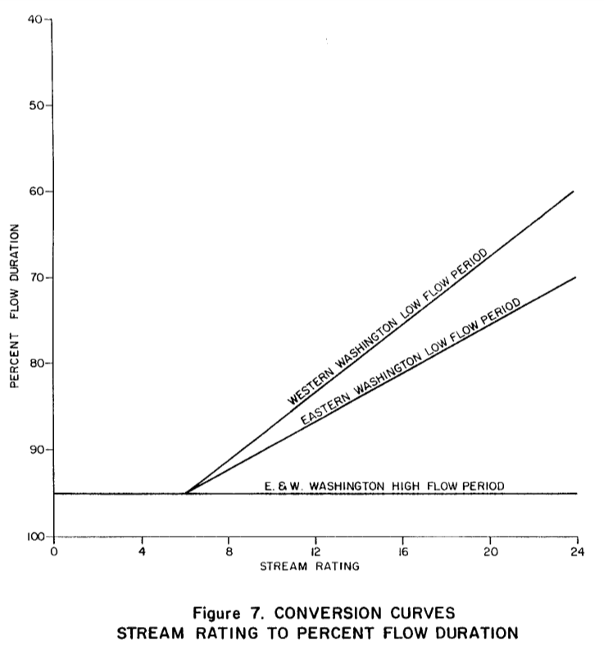
Instream Flow Protection 1974-1977
Wildlife
Fish
Scenic and
Aesthetic
Navigation
Other
Environmental
Water Quality
Notes:
There have been roughly three phases of ISF development.
This first phase of ISF development focused more on the hydrologic definition of base flow. ISFs were developed using what was loosely called the hydrologic method.
Here the stream was split into a high and a low flow period
The high flow period had ISFs set at the 95% exceedance
The low flow period had an ISF that varies between the 95 and 60% exceedance depending upon the cumulative score of 1-4 on the factors of wildlife, fish, scenic and aesthetic, navigation, other environmental values, and water quality.
The final score, ranging from 6 to 24 was converted to an exceedance level using the shown figure.

Slide 4
Instream Flow Development 1974-1977
Notes:
For example, the Chehalis River had a high flow period from December 1 to April 15, and the ISF was set at the 95% exceedance or 1300 cfs.
The low flow period was August 15 to September 15.
The Chehalis river rated fairly high with a score of 19 out of 24 which resulted in an ISF set at the 70% exceedance or 165 cfs.
A straight line was used to connect the two periods.

Slide 5
“base flow”, “minimum flow” – What does it mean?
Forrest Olson (1983) found that higher summer flows resulted in more coho adults returning two years later
Notes:
During these early years of ISF development, Hal and Brad continued their work conducting and analyzing ISF studies
The fishery community also published studies showing fish numbers to stream flow relationship.
For example, Forrest Olson (1983) found that higher summer flows resulted in more Coho adults returning two years later
All this work build a defensible case that the hydrologic method was insufficient at protecting and preserving instream resources.

Slide 6
Instream Flow Protection 1979-1985
Several instream flow models/methods were developed in the 1970s and used in Washington, but were not a principal factor until this second phase
Tennant Method
Toe-Width Method
IFIM/PHABSIM (Instream Flow Incremental Methodology/ Physical HABitat SIMulation)
Notes:
In the second phase, Ecology switched to a less comprehensive
Instream Resource Protection Program.
There were several instream flow models/methods developed in the 1970s and used in Washington, but were not a principal factor until this second phase.
These include the Tennant Method,
Toe-Width Method, and
IFIM/PHABSIM (Instream Flow Incremental Methodology/ Physical HABitat SIMulation)

Slide 7
The Tennant Method
Table 1. Instream flow regimens for fish, wildlife, recreation, and related environmental resources. (from Tennant 1976)
Oct.-Mar. Apr.-Sep.
Flushing/maximum flow 200% of the average flow - - - - -
Optimum range 60-100% of the average flow - - -
Outstanding 40% 60%
Excellent 30% 50%
Good 20% 40%
Fair 10% 30%
Poor or minimum 10% 10%
Severe degradation 10% of average flow to zero flow
Notes:
The Tennant method was a simple look up table that gave a qualitative rating of the ISF protection based on the percent of the average flow is was protecting.

Slide 8
The Tennant Method
Easy to use - no fieldwork
Non-quantitative ratings make it difficult to relate Tennant recommendations to standards found in the state instream flow statutes
Non-quantitative ratings are subjective and make it difficult to assess trade-offs
Nevertheless, AK and BC found strong support for Tennant Method for salmon and steelhead
Notes:
The Tennant method was the easyest to use.
All ratings were based on the average discharge which could be easily calculated or estimated based on watershed area and precipitation pattens and didn’t require any fieldwork.
However,
It was non-quantitative making it difficult to relate Tennant recommendations to standards found in the state instream flow statutes.
And its Non-quantitative ratings were subjective and it difficult to assess for trade-off negotiations
Nevertheless, AK and BC found strong support for Tennant Method for salmon and steelhead.

Slide 9
The Toe-width Method
Developed by Chuck Swift (USGS) under contract and in collaboration with WA Depts of Fisheries and of Game.
Used species-specific Depth and Velocity preferences to quantify to area of spawning habitat at different flows at many different sites
Regressed the flows that maximized spawning area to several watershed and channel variables
Channel width between toes of banks was best independent variable
Notes:
The toe-width method was Developed by Chuck Swift (USGS) under contract and in collaboration with WA Departments of Fisheries and of Game.
He used species-specific Depth and Velocity preferences to quantify to area of spawning habitat at different flows many different sites
Then he regressed the flows that maximized spawning area against several watershed and channel variables
Channel width between toes of banks was best independent variable

Slide 10
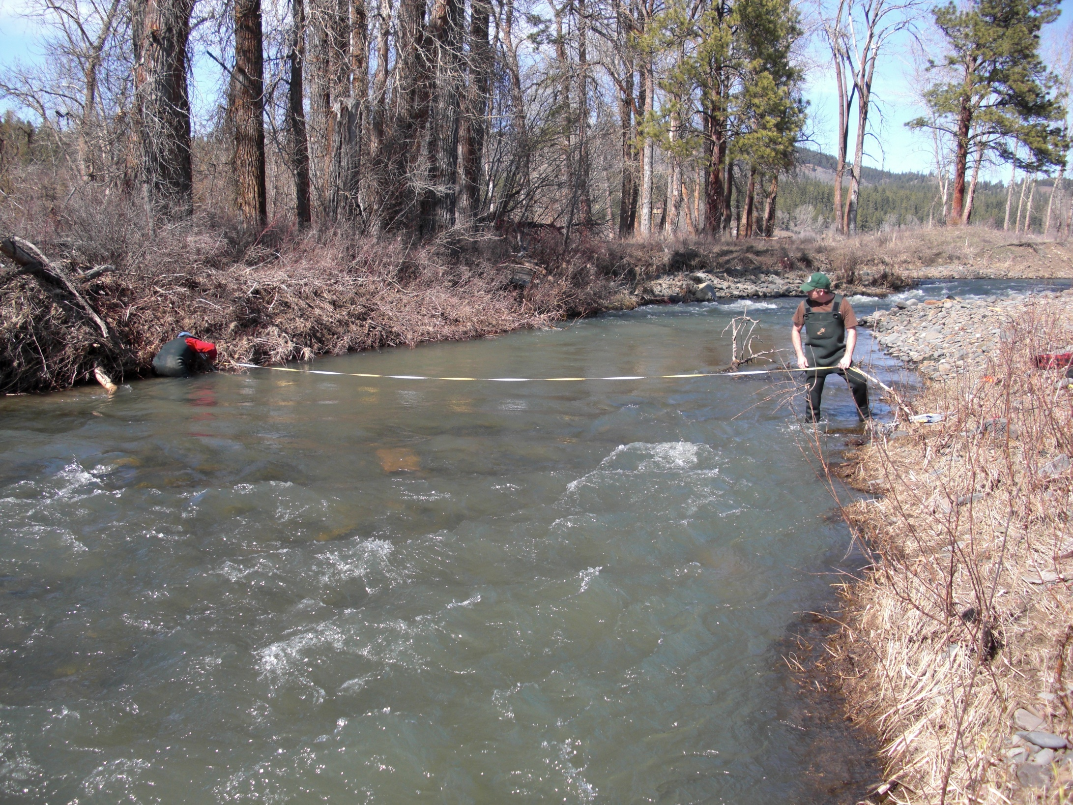
The Toe-width Method
Measuring the toe of the bank - the point where the stream bed meets the stream bank.
Notes:
The toe of the bank is the point where the stream bed meets the stream bank. When measured at pool tail-outs and riffles, the widths are quite consistent, usually within 10%.
We usually measure 4-5 transects and average the results.
This average is used in the published species specific equations to generate draft recommendations for instream flows.
This type of study is easy enough that all the key streams in an entire watershed can be measured in 1 to 3 days.

Slide 11
IFIM / PHABSIM
IFIM a 5–part process the includes using PHABSIM or a similar model
PHABSIM is set of computer models that integrate hydraulics and fish habitat preference
  Hydraulic model: determines how depths and velocities change as flow changes
  Habitat model: uses species & life-stage specific preference of Depth, Velocity, Substrate to calculate available habitat
Notes:
IFIM or Instream Flow Incremental Methodology is a 5–part process the includes using PHABSIM or a similar model
PHABSIM or Physical habitat Simulation is set of computer models that integrate stream hydraulics and fish habitat preference
Hydraulic model: determines how depths and velocities change as flow changes
Habitat model: uses species & life-stage specific preference of Depth, Velocity, Substrate to calculates the amount of habitat available at each flow

Slide 12
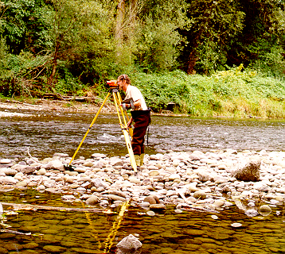
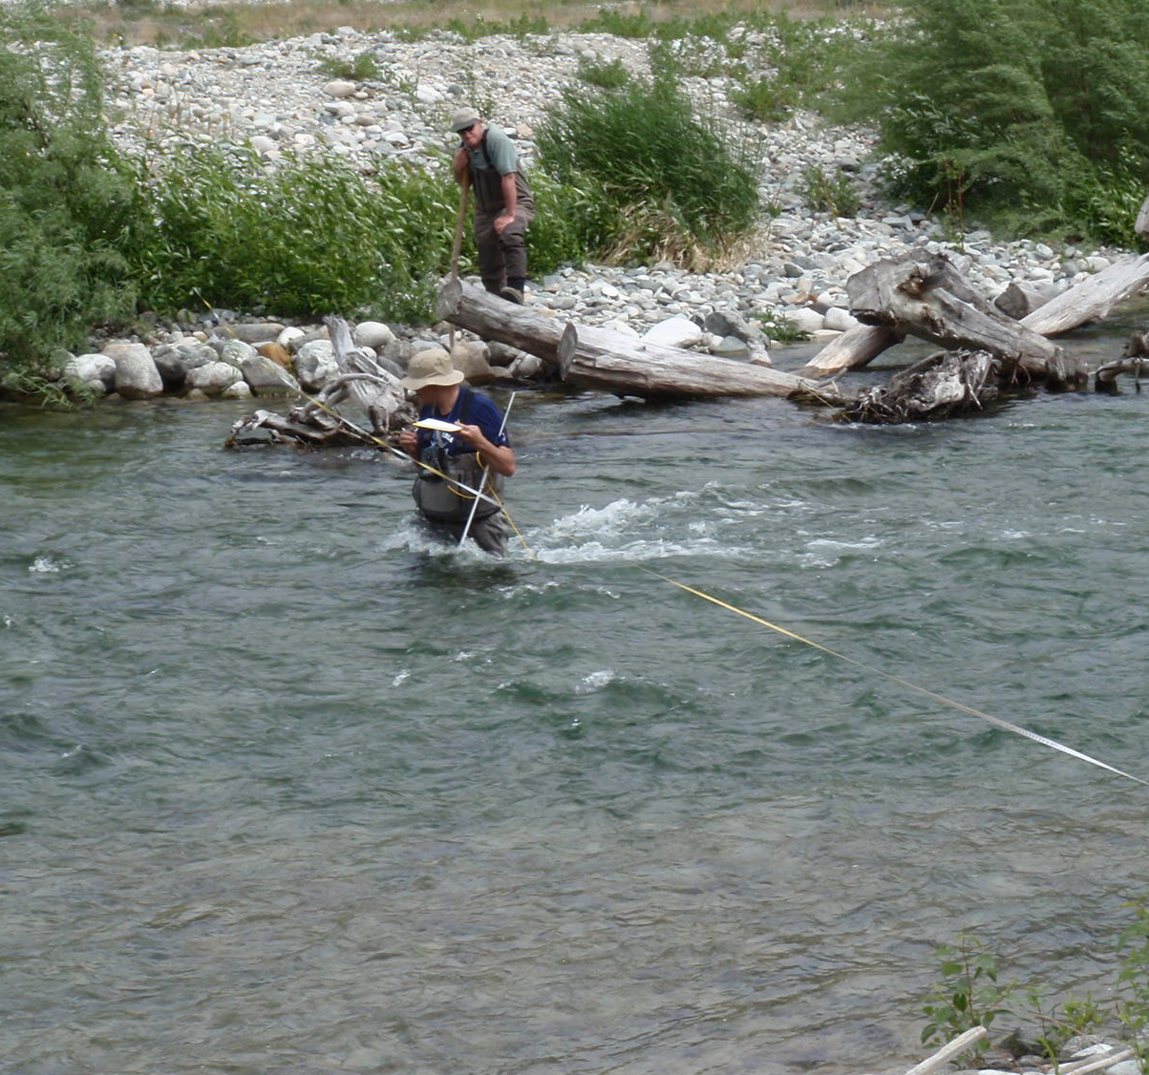
PHABSIM
Uses stream data along several cross-sections at multiple stream flows
The most detailed, site-specific instream flow method
Reliable and defensible
Used in 13 of the 17 western states and is the preferred method in 11 of them
Notes:
In the 70’s and 80’s researchers commonly measured stream data along – different transects at 1 to 3 different stream flows.
At each transect they survey water surface and bank elevations, and collected around 15 depth velocity, substrate and cover measurements along the transect.
All that data along with the habitat preference data got entered into the PHABSIM model.
This type of model is considered reliable and defensible because it is quantitative and based on biological principals.
It is also quite popular.
PHABSIM used in 13 of the 17 western states and is the preferred method in 11 of them.
Unfortunately, this method is time consuming and expensive

Slide 13
Results from a PHABSIM model
Notes:
These results from a PHABSIM model shows the relationship between flow and amount of habitat (Weighted Usable Area) produced for different species and life-stages
In general, low flows are shallow and slow and fish don’t like it.
High flows are deep and fast and fish don’t like it.
At some point, we are usually able to determine the streamflow that produces the most fish habitat for each species and life history.

Slide 14
Instream Flow Development 1979-1985
Notes:
In the second phase, we saw a greater reliance on quantitative fish habitat models to determine an ISF.
For example, on this exceedance hydrograph of the e Duckabush river, the black line shows the recommend flows based on the PHABSIM study.
The green line was the negotiated instream flow.
The rationale for the difference was not mentioned, but the ISF in this phase seemed to have a limit of around the 50% exceedance flow during the wet season and about the 40% exceedance during the dry season.
Because of the greater reliance on habitat studies and a philosophy change on hydrologic limits, ISFs set during this period were more protective.

Slide 15
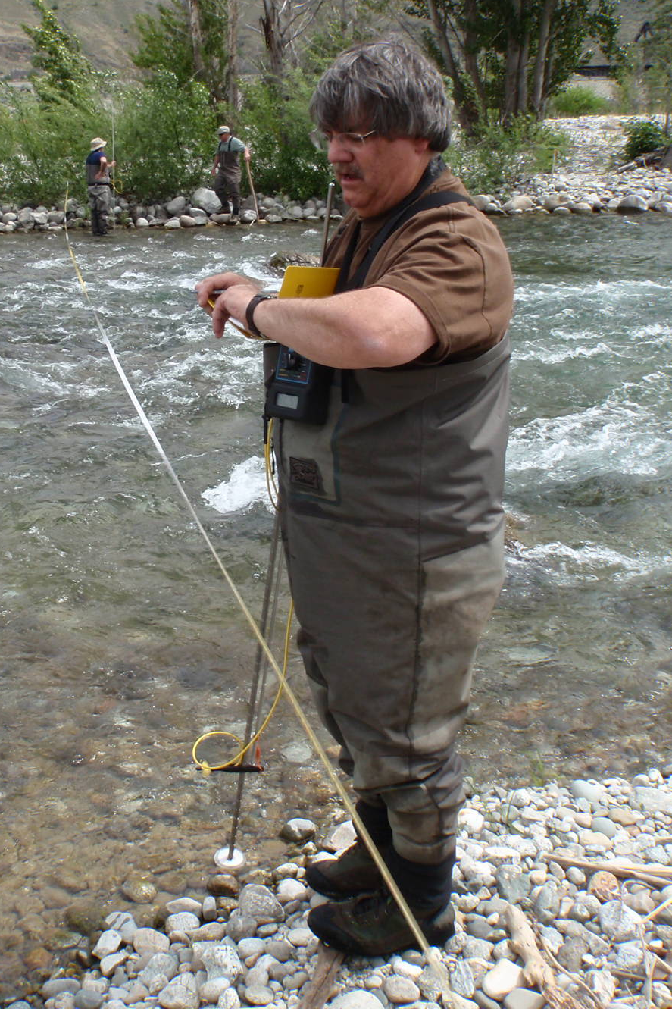
Instream Flow Protection 1986-2003
The Dark Ages
Instream flow rule making took an 18 year hiatus
Fishery community continued to test method assumptions leading to improved methods
New instream flow studies and fish habitat research continued
Ken Slattery’s leadership solidified the state’s authority to set ISFs at hydroelectric projects through the Elkhorn decision
Notes:
Instream flow rule making took an 18 year hiatus
Fishery community continued to test method assumptions leading to improved methods
New instream flow studies and fish habitat research continued
Ken Slattery’s leadership solidified the state’s authority to set ISFs at hydroelectric projects through the Elkhorn decision.
So while ISF rules were on hold during this period, numerous ISF were set on hydro-projects across the state.

Slide 16
Instream Flow Protection 2004-2015
Ecology hired a new biologist and increased the size of WDFWs water team
PHABSIM and Toe-width were still our preferred instream flow method
Assumptions continued to be tested, and valid criticisms resulted in improved methods
Additional improvements were gained as we developed a better understanding of fish habitat
Notes:
Ecology hired a new biologist and increased the size of WDFWs water team
PHABSIM and Toe-width were our preferred instream flow method
Assumptions continued to be tested, and valid criticisms resulted in improved methods. For example, we increased the number of transects needed for a study to around 8 and now we use around 12.
Additional improvements were gained as we developed a better understanding of fish habitat resulting in ore accurate fish preference curves

Slide 17
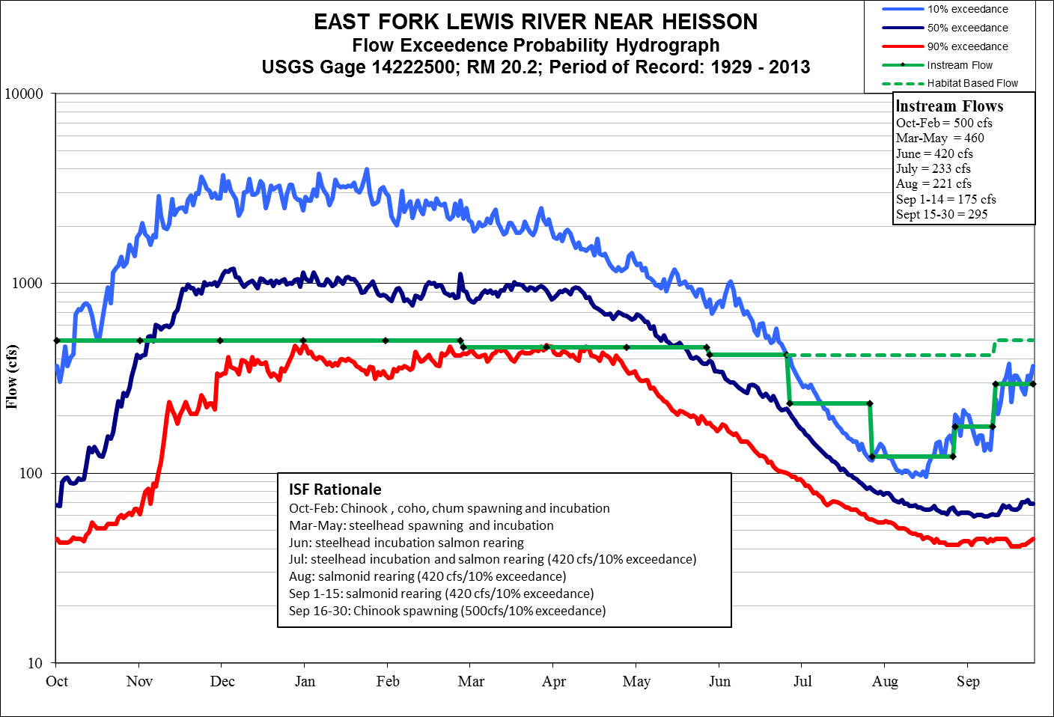
Instream Flow Development 2004-2015
Notes:
In this phase of instream flow development we continue to rely on habitat studies to provide a resource –focused ISF recommendation.
We also use a hydrologic limit, usually in the low flow season, but because we have found that even the rare flow events can provide a benefit to rearing fish populations, we now use the 10% exceedance as our ISF limit.

Slide 18
Instream Flow Protection 2016-????
We are again on an instream flow rule hiatus
WDFW and Ecology continue to conduct instream flow studies and look at ways to improve instream flow science
Future improvements include:
  A revised and updated toe-width method
  A critical riffle analysis for upstream migration
  A statistical verification of our preference curves
  Science marches on, even during the dark ages
Notes:
What does the future hold?
We are again on an instream flow rule hiatus
Again, WDFW and Ecology continue to conduct instream flow studies and lookiat ways to improve instream flow science
Future improvements include:
A revised and updated toe-width method
A critical riffle analysis for upstream migration
Science marches on-even during the dark ages

